Slide 1

Titanic Survived Statistics
By
Salah Barakat
Supervised by
Eng. Ahmed emad

Slide 2
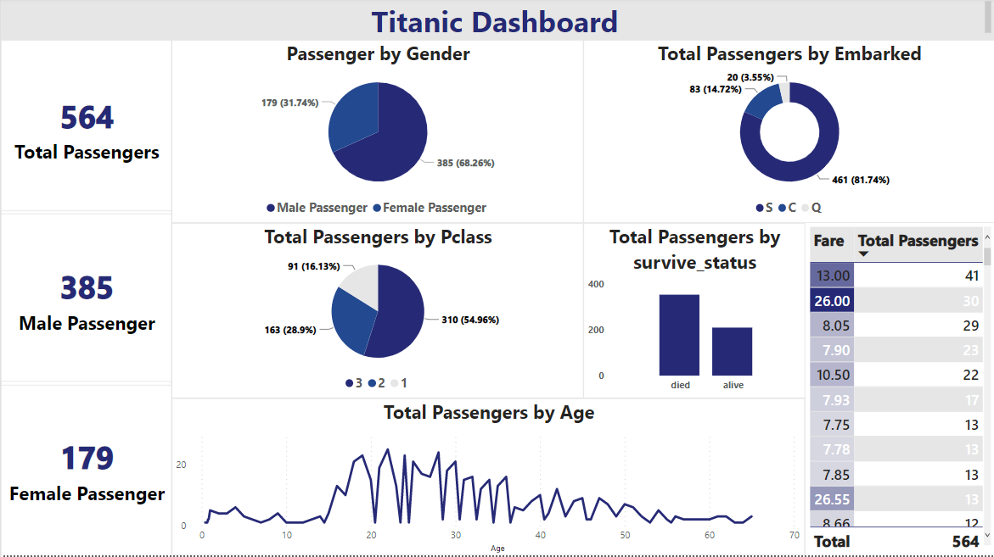

Slide 3
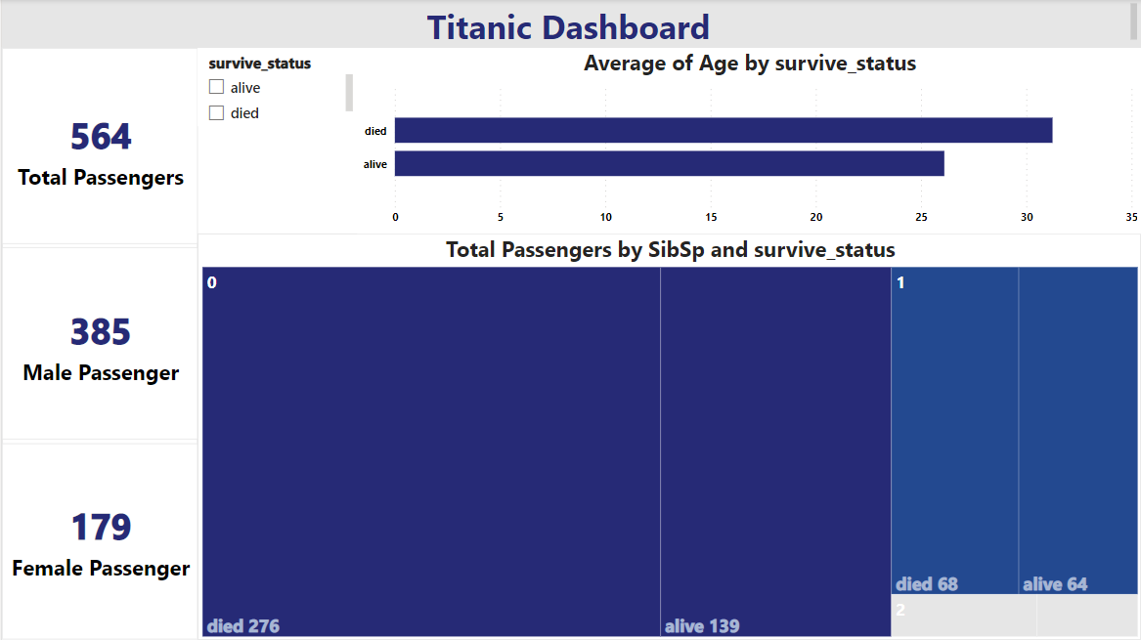

Slide 4
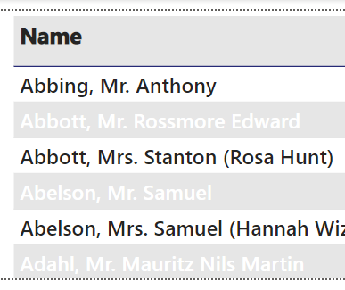
Tooltip for second dashboard

Slide 5
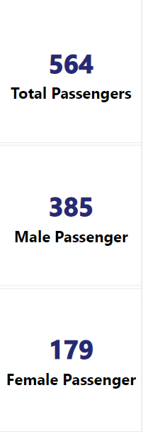
overview dashboard
This chart called card.
I make 3 cards represent the number of all passengers and the number of male and female passengers.

Slide 6
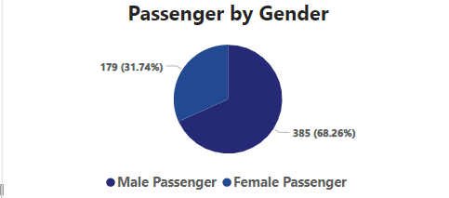
overview dashboard
I make this Pie chart to represent the percentage of male and female passengers and I found that the big percentage belongs to male passengers.

Slide 7
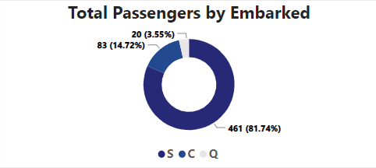
overview dashboard
I make this Donut chart to show the total passengers depend on the port from which they boarded the ship.
There are three ported Cherbourg represented by S, Queenstown represented by Q and Southampton represented by S.
I found that most of the passengers boarded from Southampton(S) port.

Slide 8
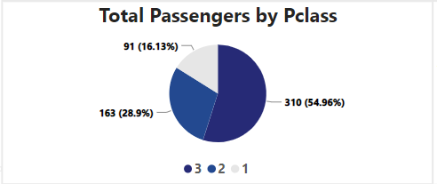
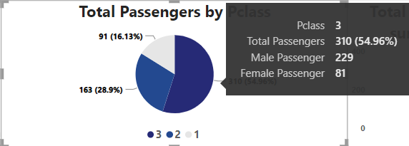
overview dashboard
I make this Pie chart to represent the number and percentage of all passenger depend on the Pclass and there are 3 classes first, second and third.
As shown in figure 1 the big number and percentage is class 3.
If I stop on a part of the Pie chart I can see the number of all passenger of this class, the percentage and the number of male and female as shown in figure 2
Figure 1
Figure 2

Slide 9
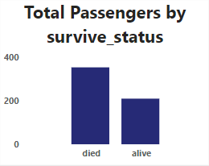
overview dashboard
In this clustered column chart, I shown the number of died and alive people and I found the died is the most.

Slide 10
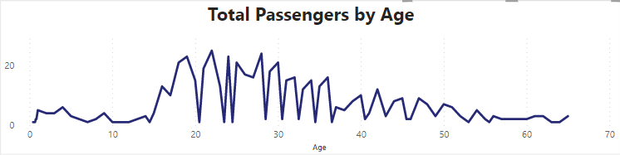
overview dashboard
In this line chart, I show the ages of all passengers and I found that the most range of them is between 19 and 30 years old.

Slide 11
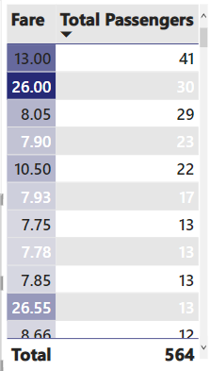
overview dashboard
In this table, I show the number of passenger depends on the fare they paid.
And I make the rows with colors in different degrees depends on which is big.

Slide 12
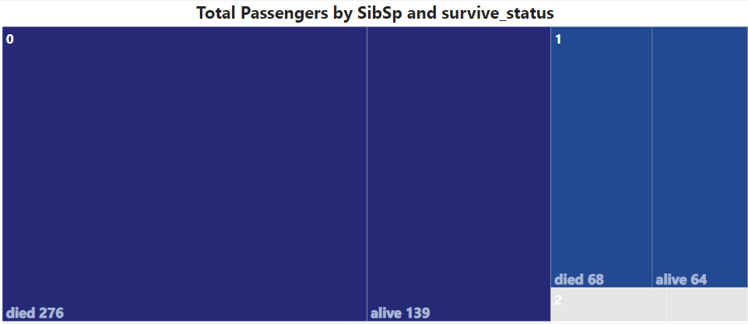
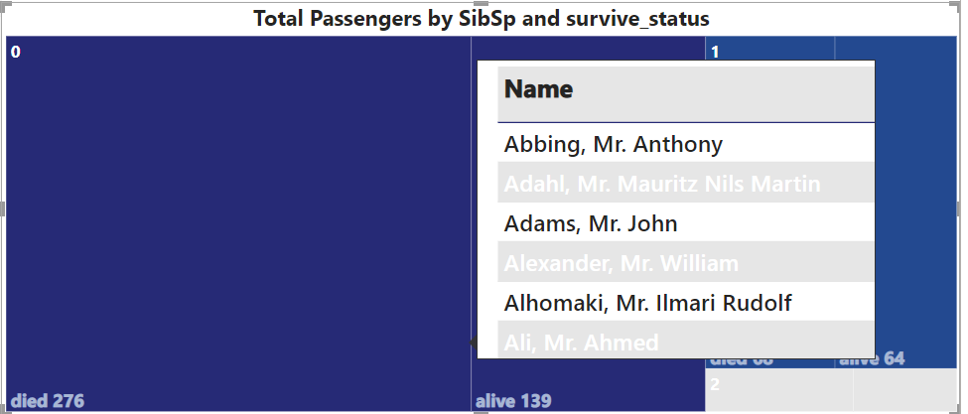
Details dashboard
Figure 1
I make this treemap to show the total passengers depend on SibSp(number of brothers and sisters) and servive status(died or alive ) as shown in figure 1.
If I stopped on this treemap it shows me the names of passenger who lived or died as shown in figure 2 depend on the tooltip I had made as I had shown in slide 3.
Figure 2

Slide 13
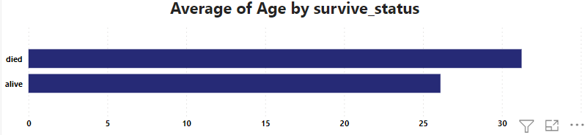

Details dashboard
In this clustered bar chart as shown in figure 1, I show the average ages of died and alive passenger.
As shown in figure 2 this is a slicer to filter data depend on died or alive passengers.
When I click on died or alive it make all charts shown data for I had chosen.
Figure 1
Figure 2

Slide 14
Any questions?
Thanks for your time <3

